Slide 1
Saeid - The warmest and coldest day of each year
C++
Coding
year.txt
month.txt
Bash script
smhi-opendata-Lund.csv
day.txt
time.txt
temperature-01.txt
WarmestDaysHist.txt
ColdestDaysHist.txt
Filling histogram and performing fitting
Root

Slide 2
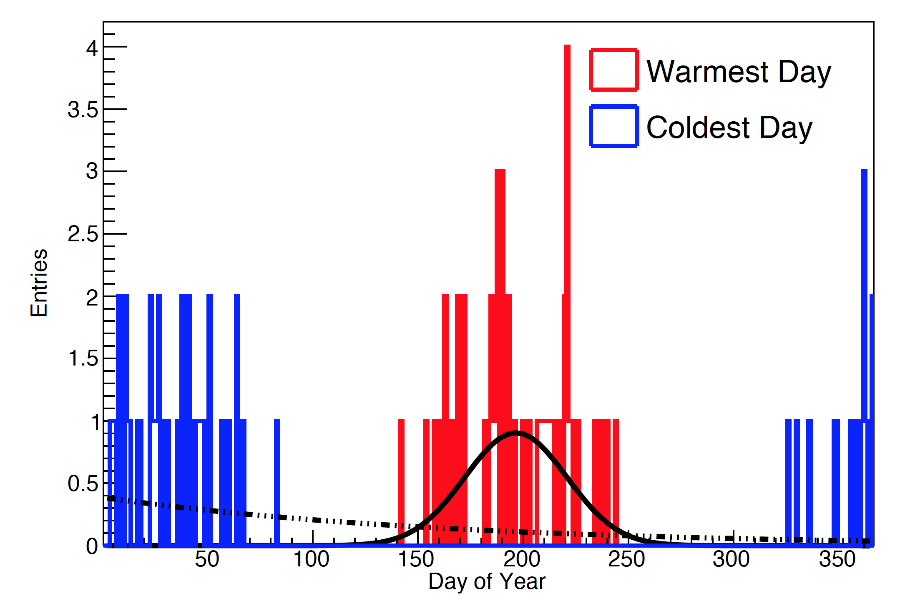
Saeid - The warmest and coldest day of each year

Slide 3
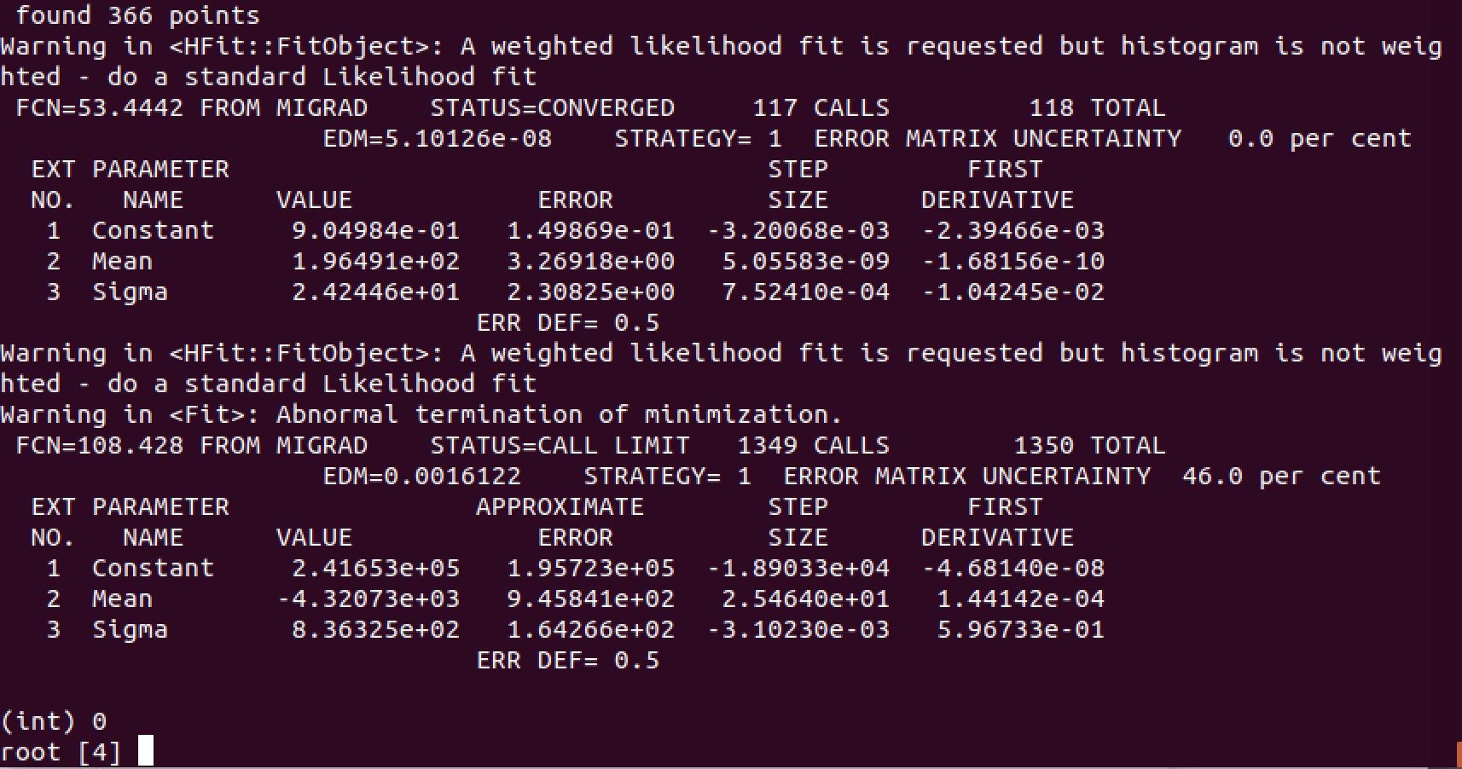
Saeid - The warmest and coldest day of each year

